Slide 1


Happy Feets
An E-Commerce Website

Slide 2
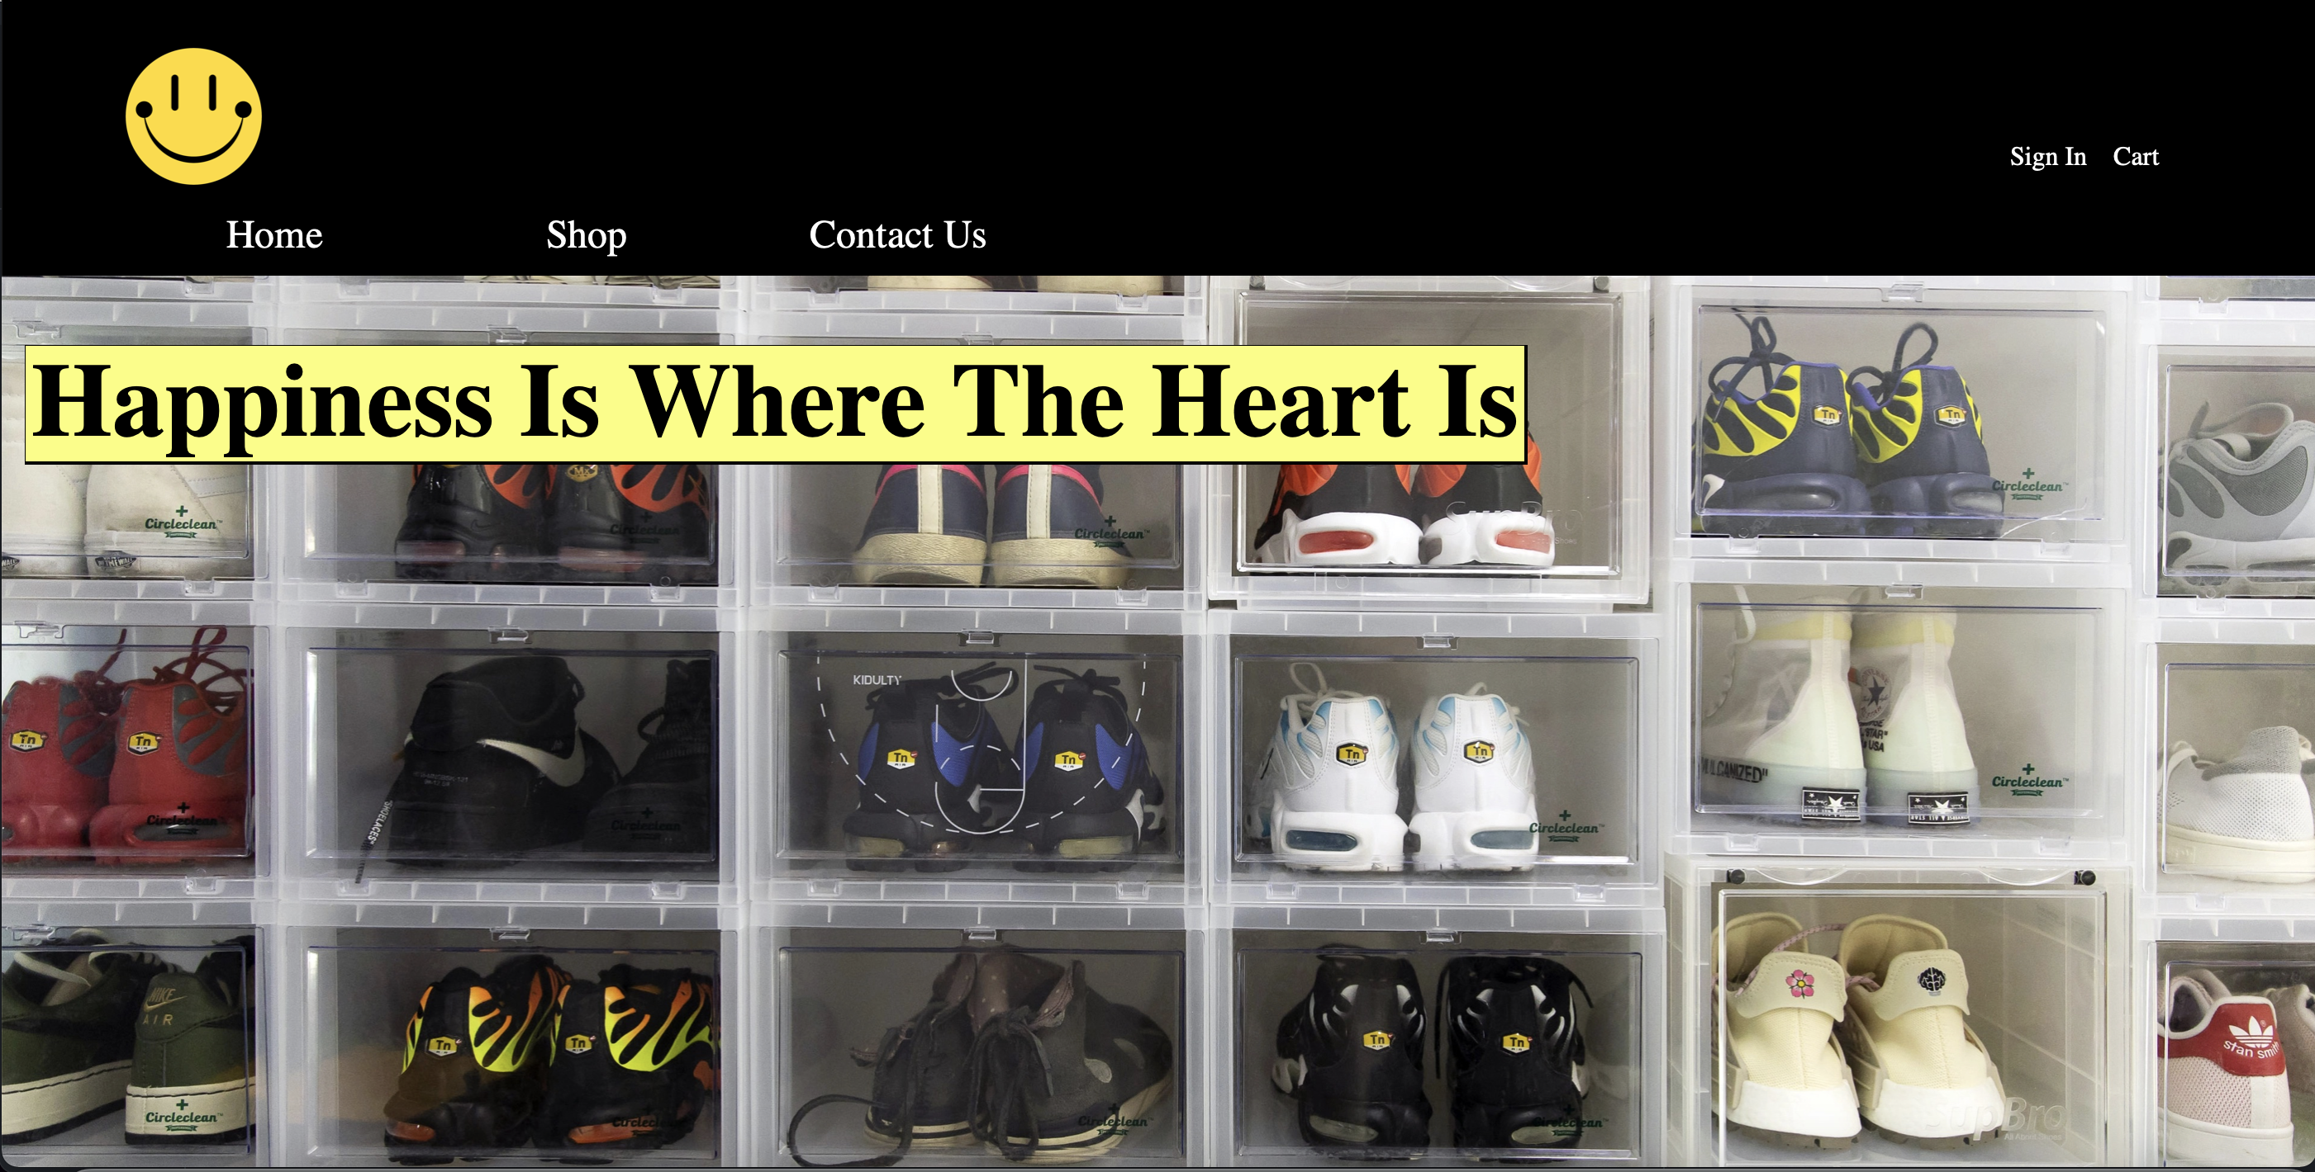

Slide 3
Background
I started the Happy Company around late 2021. It is my first real business venture. Starting from the ground up, I sell clothes from various vendors, as well as resell sneakers. My clothing store is called Happy Fits, while my sneaker store is called Happy Feets.
I originally sold my products using a Shopify-built website for Happy Fits. But I eventually moved all my products to my eBay instead.
After realizing how much I despise eBay’s (and other platforms’) selling fees, I decided I need to build a website for one of my brands. Which is how I had got the idea for this project.

Slide 4
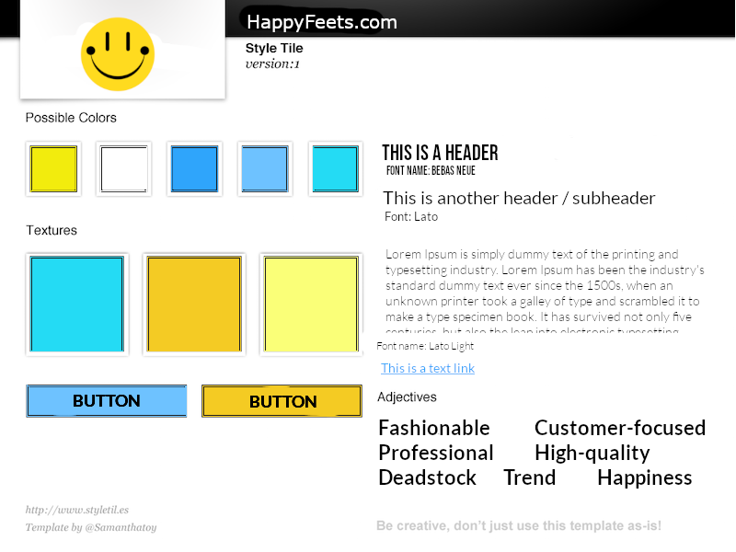
Design Choices
For my color scheme I chose mainly shades of blues and yellows.
Yellow, because it is my favorite color; also, it invokes feelings such as happiness, hope, and optimism
Blue, because it represents dependability, reliability, and security
These are all feelings I would want the customer to feel as they browse the website.

Slide 5
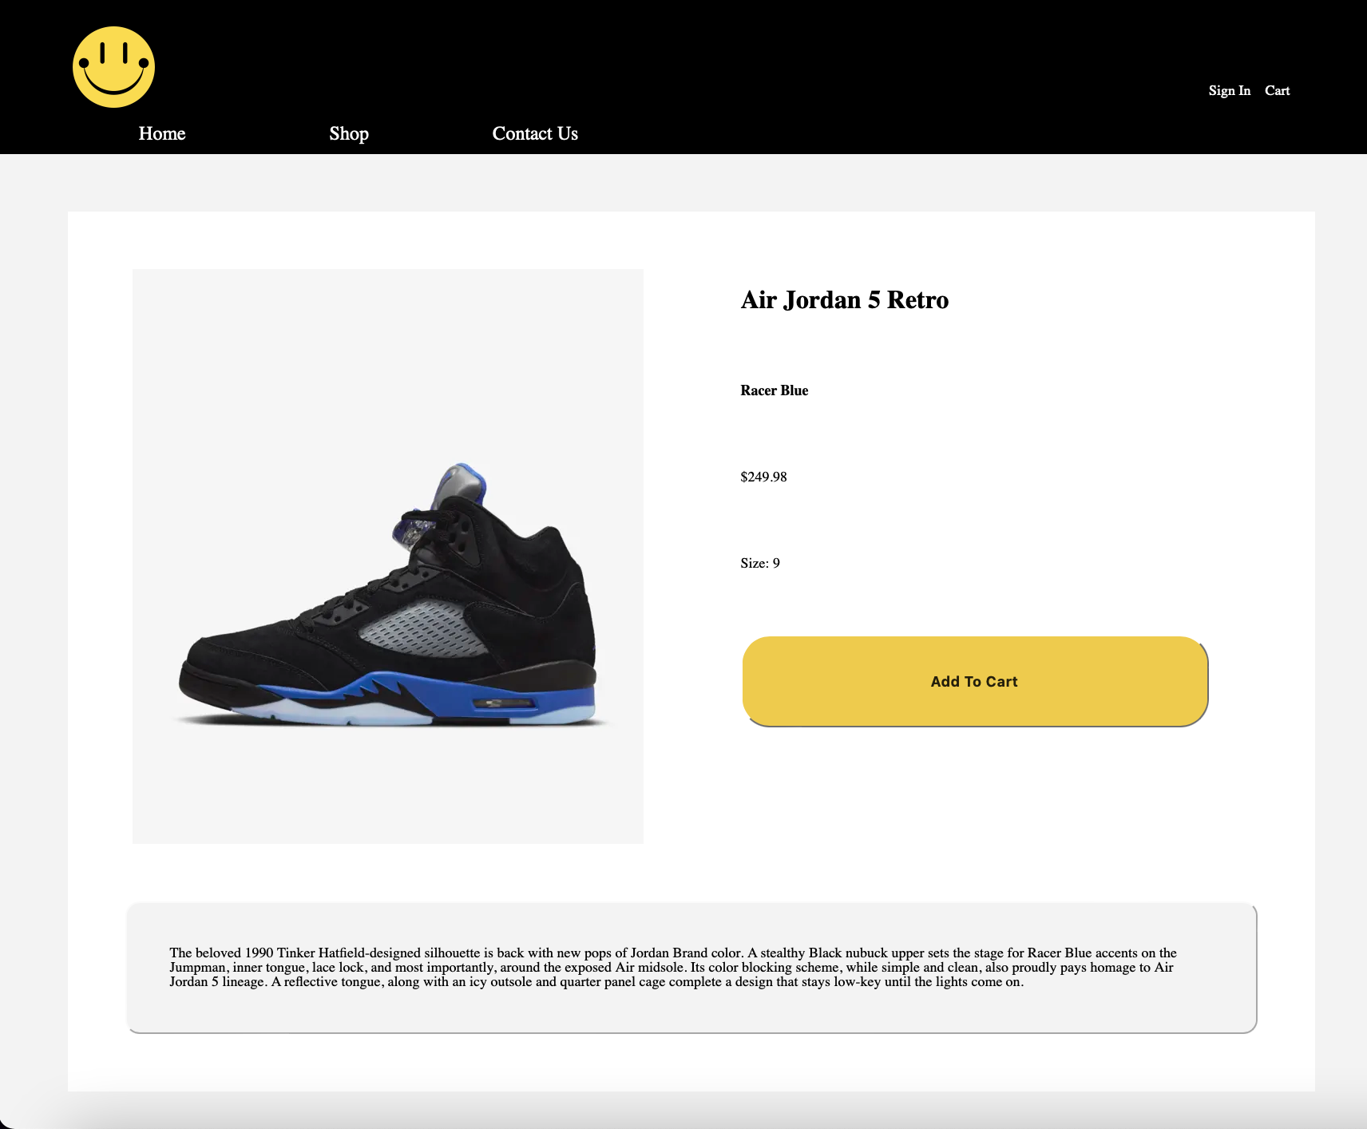

Slide 6
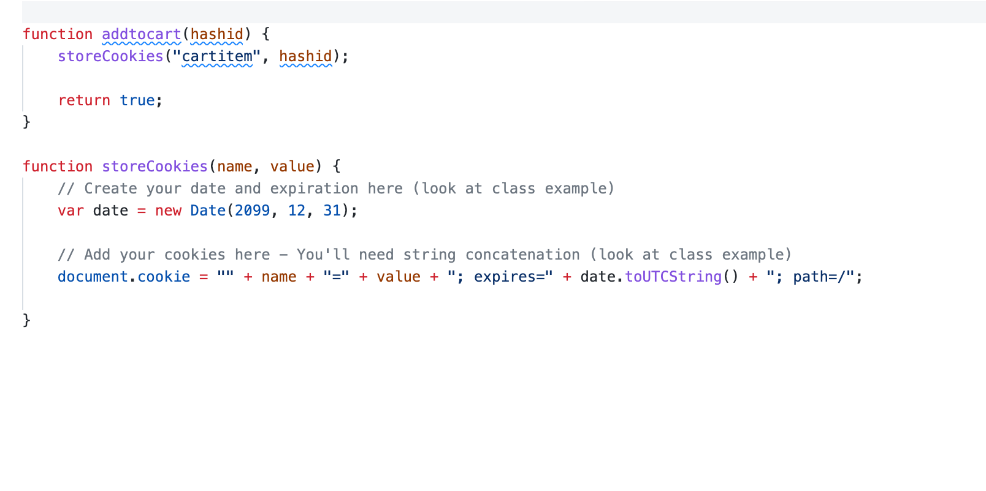
Javascript Features
JavaScript is utilized in multiple different sections of the website.
Most notably, it is used to dynamically load the header and footer into each of the webpages using jQuery.
It is also used to allow the customer to add an item to the cart *
Currently, however, only one item can be added to the cart at a time, this will be something I will work more on in the future.

Slide 7
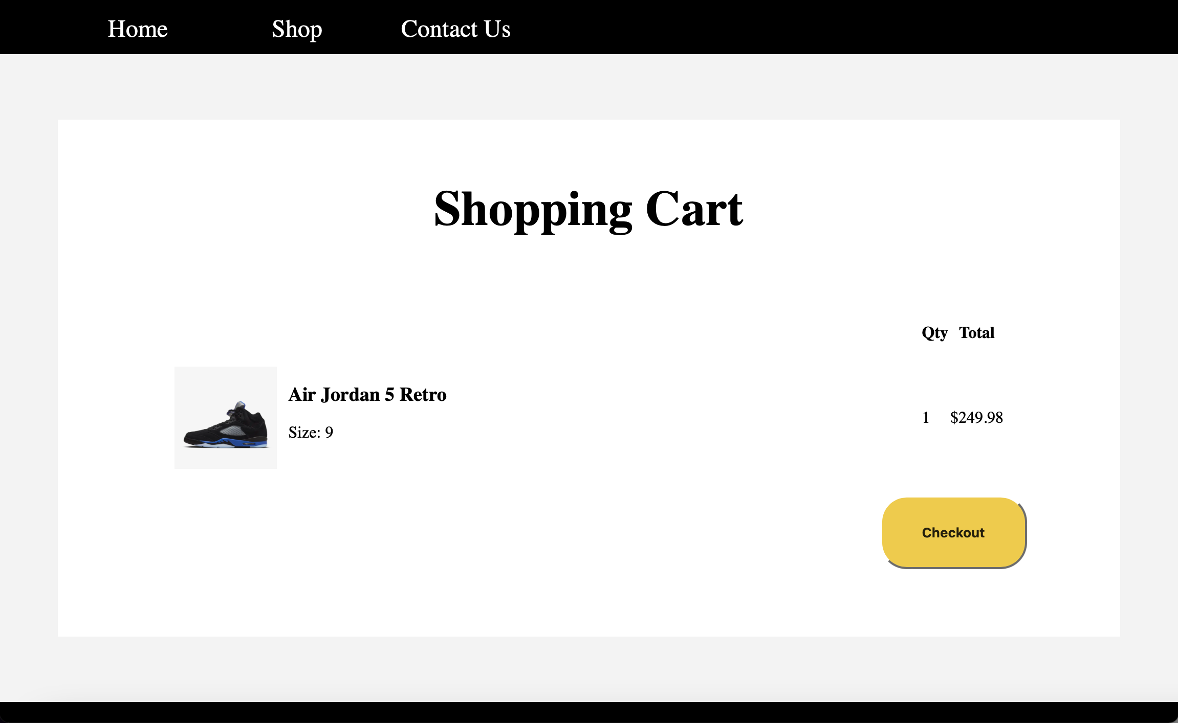

Slide 8
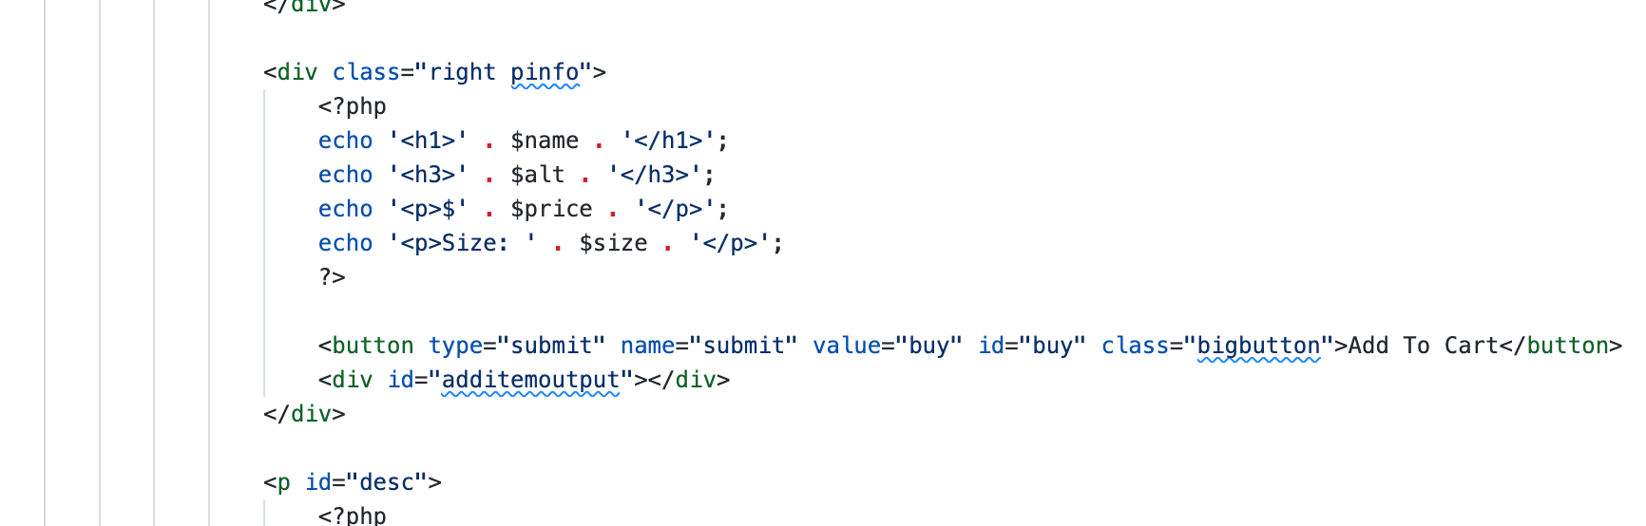
PHP Features
PHP is used throughout the entire website.
It is used for loading products from the database onto the pages.
Individual product pages are generated from a GET link that is created by the ’Shop’ page

Slide 9
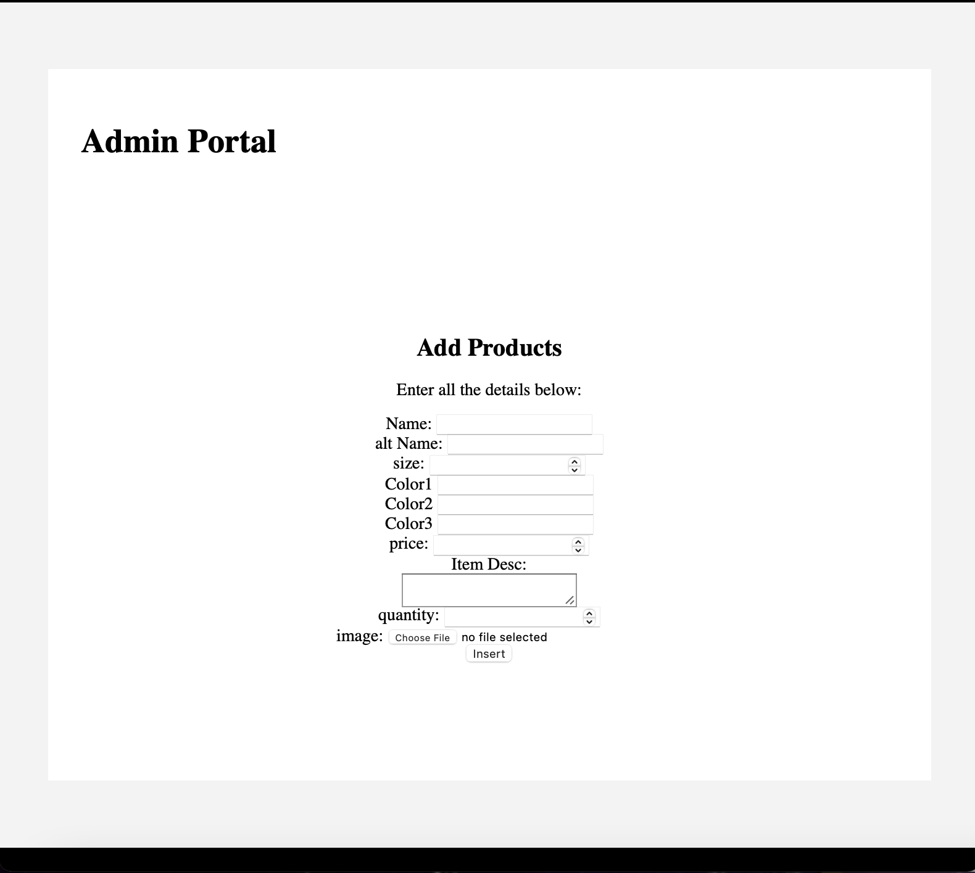
Database Features
As mentioned in the last slide, the database is the backbone of the website.
All products are loaded in according to their database entry.
I created an admin portal on the website which allows me to easily add products to the database.

Slide 10

Accomplishments
I am particularly proud of getting the database to properly sync with the webpages using PHP. I never had experience with the language prior to this class so it was a new and exciting experience for me.
Also figuring out how to properly add pictures into the database and have them load on the website was also very a big achievement.
I also learned how to make the URLs not include ‘.php’ at the end which makes them look neater

Slide 11

Next Steps
I plan on continuing to build this website even after the final. I have working as hard as I can to make this as functional as possible so I can open it as my webstore.
As of right now, you cannot checkout any items as I haven’t implemented a payment system.
Also, most of the products in the database are just test dummies from when I was testing the admin page feature; so, I need to add more of my actual inventory.

